Slide 1
















LIVING ROOM

Slide 2



THE PLAYGROUND

Slide 3











TRAINING HALL

Slide 4
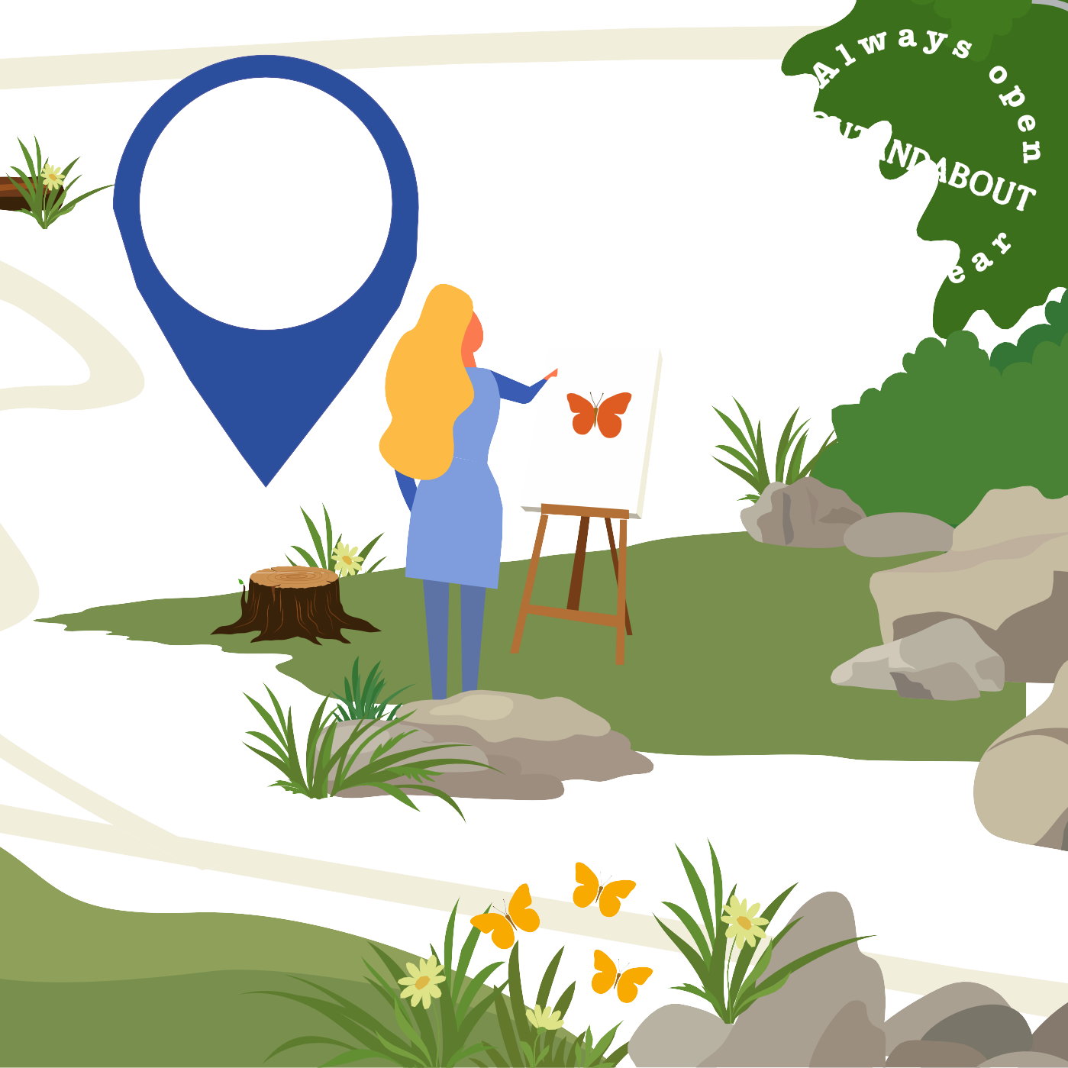
ART STUDIO

Slide 5


RESEARCH LABORATORY

Slide 6
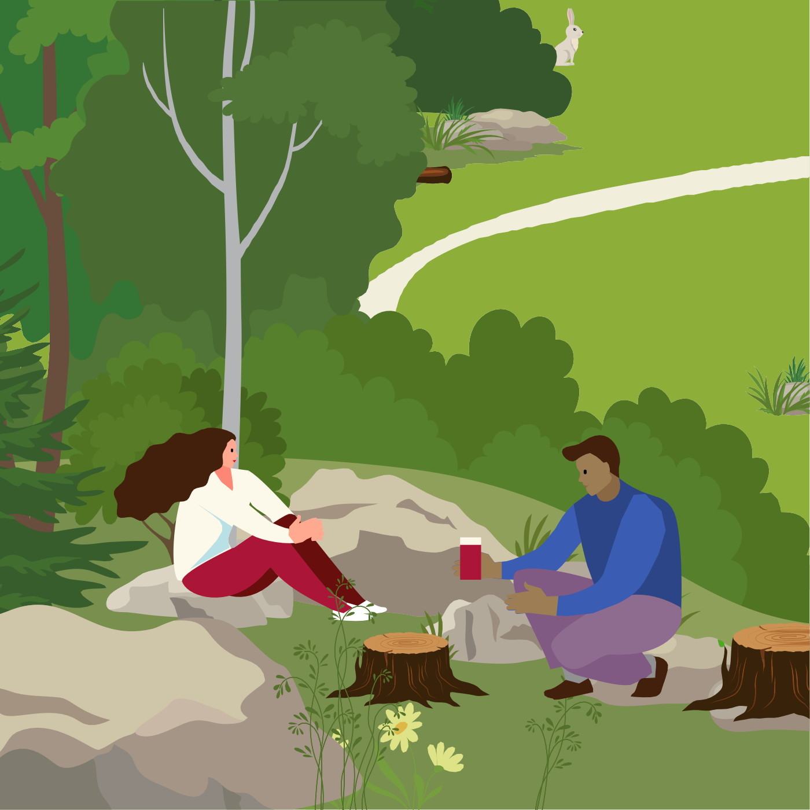







PICNIC SITES

